Slide 1
Efficiency Measure in Insurance Industry –
A Network DEA Model
Operation Research Application
Advisor: 李家岩
Presenter: 吳延東

Slide 2
Efficiency Measure in Insurance Industry – A Network DEA Model
Background and Motivation
Kao and Hwang (2008) —the first study that applies Network-DEA to the insurance field, which consists of 24 non-life insurance firms in Taiwan between 2001 and 2002. Subsequently, several scholars use the same dataset in Kao and Hwang (2008) to test new Network-DEA models.
When it comes to efficiency measure in insurance industry nowadays. It’s difficult to collect similar data since the change in financial statement over 15 years.
Furthermore, network framework from Kao and Hwang (2008) should be update.
We proposed a three stage network system which contains three processes, premium acquisition, reinsurance allocation and profit generation.

Slide 3
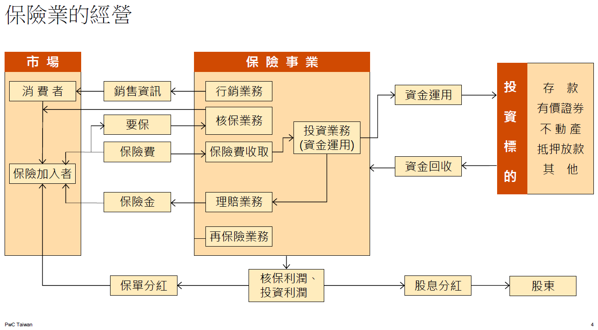
Efficiency Measure in Insurance Industry – A Network DEA Model
Background and Motivation
保險業務會影響再保分保業務
理賠與投資同時進行

Slide 4
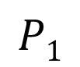
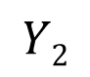
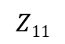
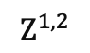
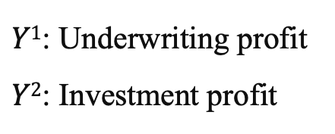
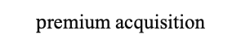
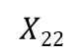
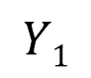
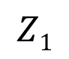
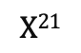
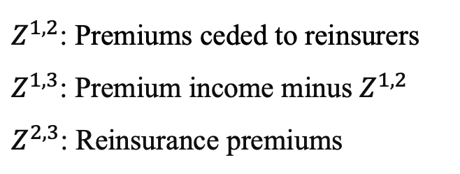
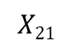
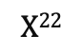
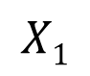
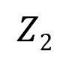
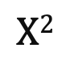
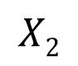
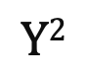

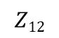
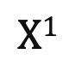
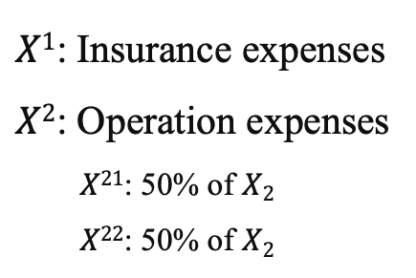
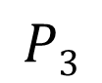
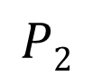
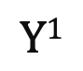
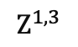
Efficiency Measure in Insurance Industry – A Network DEA Model
Methodology - network DEA model
Notations:
$X1$: Insurance expenses
$X2$: Operation expenses
$X21$: 50% of $X2$
$X22$: 50% of $X2$
$Z^{1,2}$: Premiums ceded to reinsurers
$Z^{1,3}$: Premium income minus $Z^{1,2}$
$Z^{2,3}$: Reinsurance premiums
$Y1$: Underwriting profit
$Y2$: Investment profit
$$X1$$
$$Z^{1,3}$$
$$Y1$$
$$p\text{remium} \text{acquisition}$$
$$X21$$
$$Z^{1,2}$$
profit generation
$$X2$$
$$Z^{2,3}$$
$$Y2$$
reinsurance allocation
$$X22$$
$$X1$$
$$P1$$
$$Z1$$
$$Y1$$
$$Z12$$
$$X21$$
$$P3$$
$$Z11$$
$$X2$$
$$P2$$
$$Z2$$
$$Y2$$
$$X22$$

Slide 5


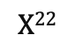
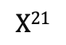


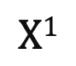
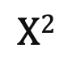

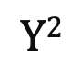
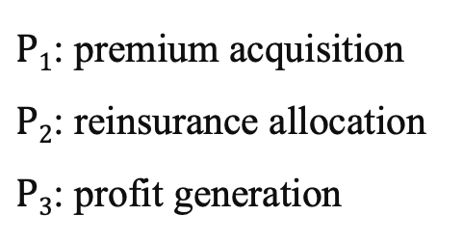
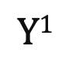
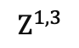
Efficiency Measure in Insurance Industry – A Network DEA Model
Methodology - network DEA model
Notations:
$X1$: Insurance expenses
$X2$: Operation expenses
$X21$: 50% of $X2$
$X22$: 50% of $X2$
$Z^{1,2}$: Premiums ceded to reinsurers
$Z^{1,3}$: Premium income minus $Z^{1,2}$
$Z^{2,3}$: Reinsurance premiums
$Y1$: Underwriting profit
$Y2$: Investment profit
$$X1$$
$$P1$$
$$Z^{1,3}$$
$$Y1$$
$P1$: premium acquisition
$P2$: reinsurance allocation
$P3$: profit generation
$$X21$$
$$Z^{1,2}$$
$$P3$$
$$X2$$
$$P2$$
$$Z^{2,3}$$
$$Y2$$
$$X22$$

Slide 6
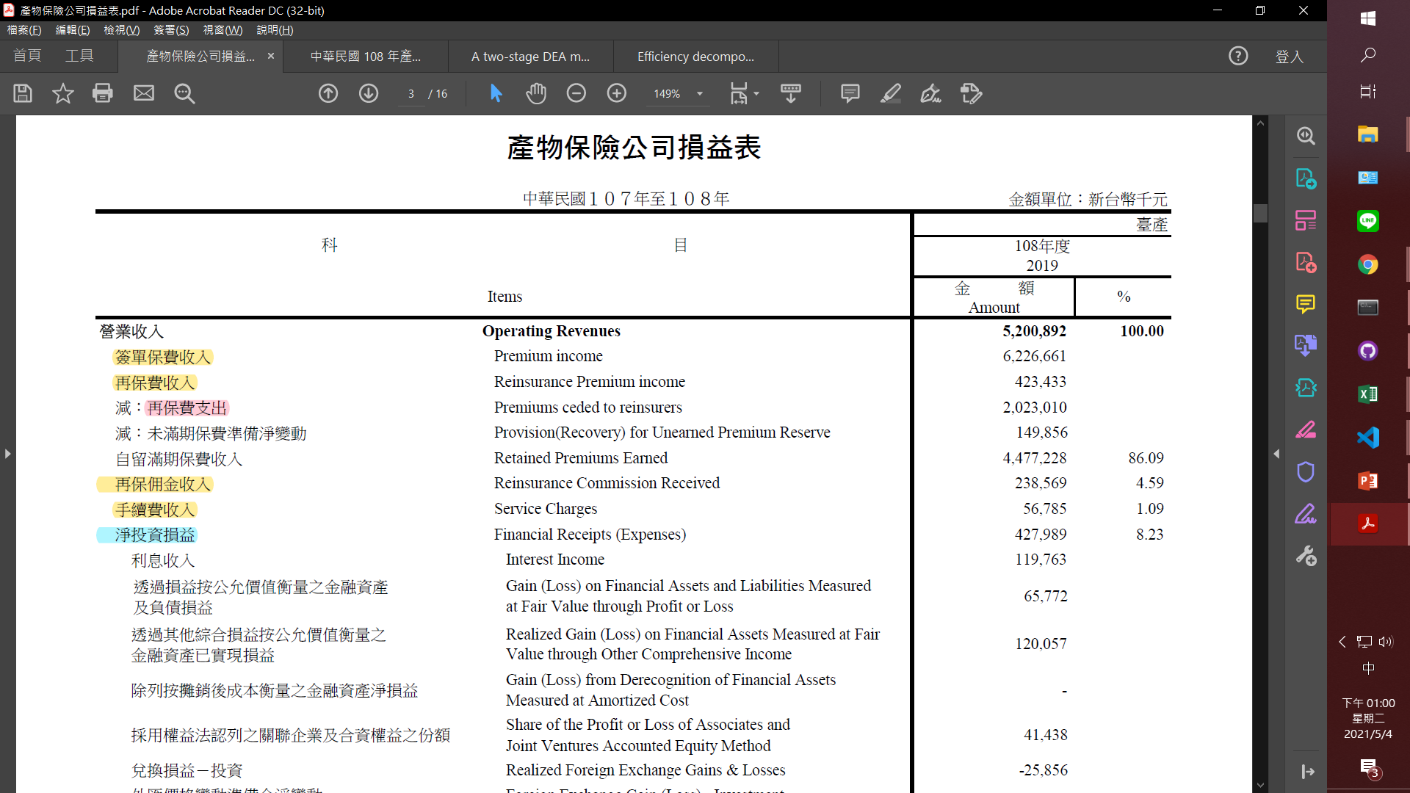
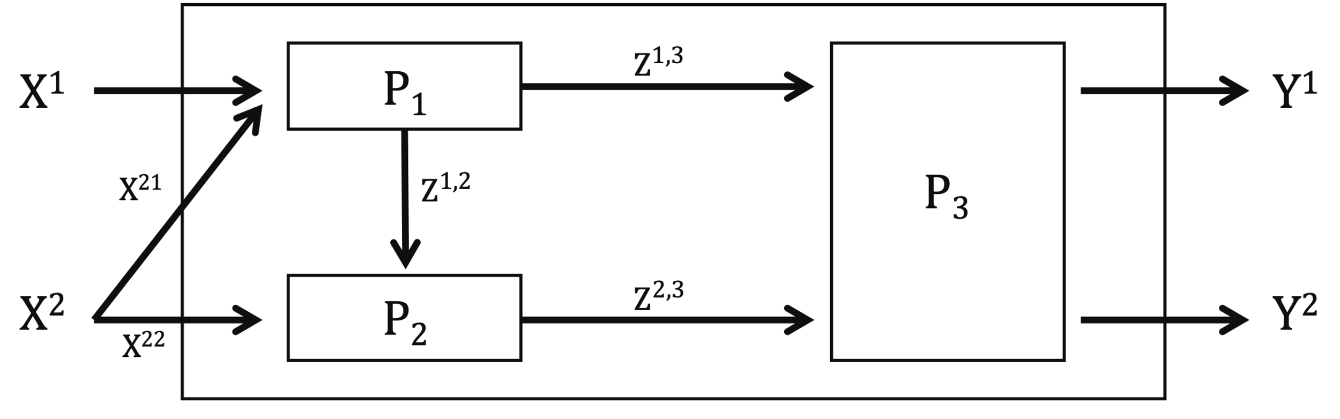

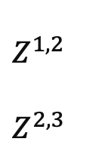
Efficiency Measure in Insurance Industry – A Network DEA Model
Data Collection
https://www.tii.org.tw/tii/actuarial/actuarial1/report/result.html
$Z^{1,2}$
$Z^{2,3}$
Y²

Slide 7
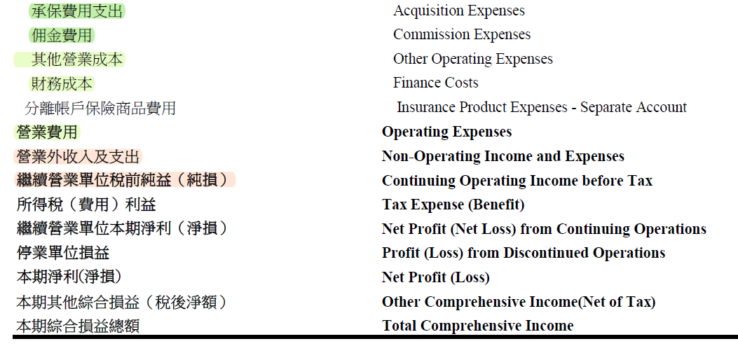
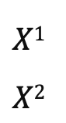
Efficiency Measure in Insurance Industry – A Network DEA Model
Data Collection
https://www.tii.org.tw/tii/actuarial/actuarial1/report/result.html
$X1$
$X2$
Notes:
Y1 （> 0）解法 ：
把所有人加上一個固定值，不會影響績效排序，但是有可能有彼此的效率變得更接近（ORA）
法二：
另外跟老師要

Slide 8
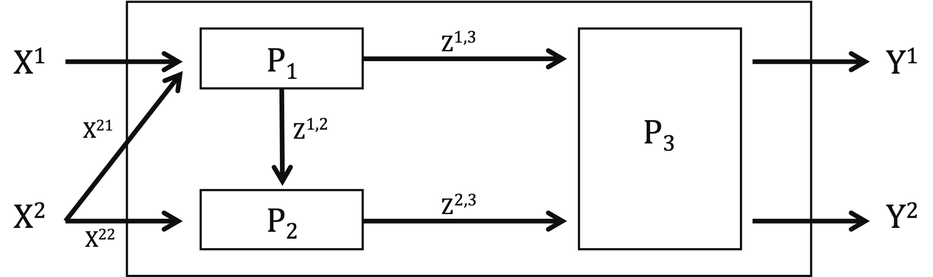
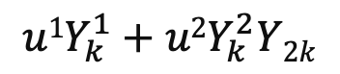
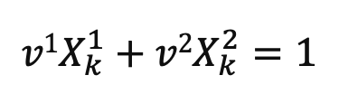
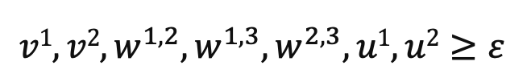
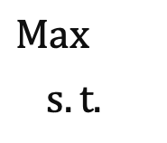
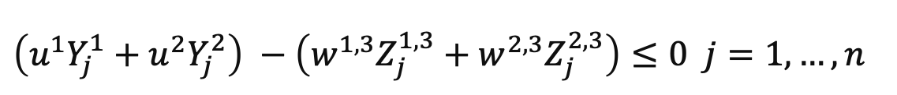
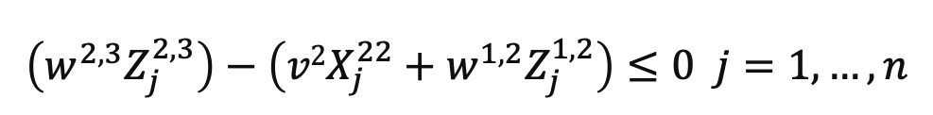
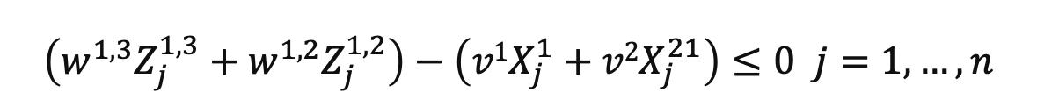
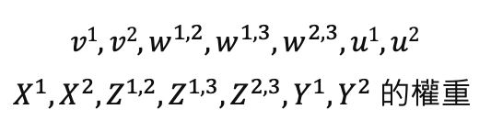
Efficiency Measure in Insurance Industry – A Network DEA Model
Methodology - network DEA model
CRS
$$Max$$
$s.t.$
$$u1Y_{k}^{1}+u2Y_{k}^{2}Y2k$$
$$v1X_{k}^{1}+v2X_{k}^{2}=1$$
$$\left(w^{1,3}Z_{j}^{1,3}+w^{1,2}Z_{j}^{1,2}\right)−\left(v1X_{j}^{1}+v2X_{j}^{21}\right)≤0 j=1,…,n$$
P₁
$$\left(w^{2,3}Z_{j}^{2,3}\right)−\left(v2X_{j}^{22}+w^{1,2}Z_{j}^{1,2}\right)≤0 j=1,…,n$$
P₂
$$v1, v2, w^{1,2},w^{1,3},w^{2,3}, u1, u2$$
$X^{1},X^{2},Z^{1,2},Z^{1,3},Z^{2,3},Y^{1},Y^{2}$ 的權重
$$\left(u^{1}Y_{j}^{1}+u^{2}Y_{j}^{2}\right) −\left(w^{1,3}Z_{j}^{1,3}+w^{2,3}Z_{j}^{2,3}\right)≤0 j=1,…,n$$
P₃
$$v1, v2, w^{1,2},w^{1,3},w^{2,3}, u1, u2≥ε$$

Slide 9
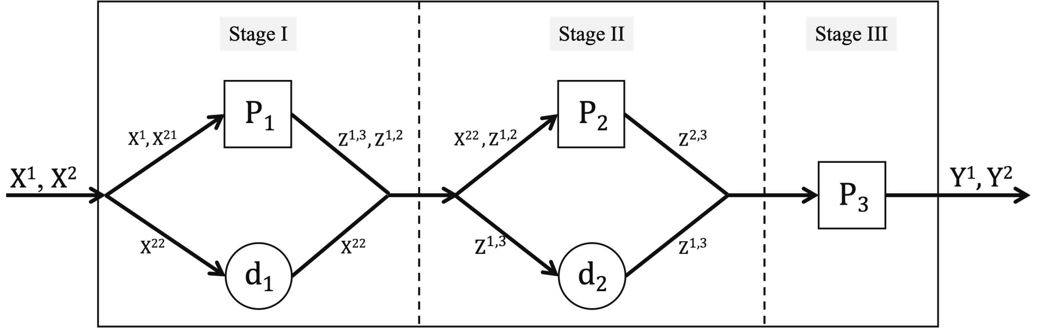
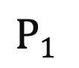














Stage I
Stage II
Stage III
$$P1$$
$$P2$$
$$X1, X21$$
$${Z^{1,3}, Z}^{1,2}$$
$${X22 , Z}^{1,2}$$
$$Z^{2,3}$$
$X1$, $X2$
$$Y1, Y2$$
$$P3$$
$$X22$$
$$X22$$
$$Z^{1,3}$$
$$Z^{1,3}$$
$$d1$$
$$d2$$
Efficiency Measure in Insurance Industry – A Network DEA Model
Methodology - network DEA model
CRS
dummy process

Slide 10





Efficiency Measure in Insurance Industry – A Network DEA Model
Methodology - network DEA model
CRS
$$E_{k}^{(1)}=(w^{1,2*}Z_{k}^{1,2}+w^{1,3∗}Z_{k}^{1,3})/\left(v^{1∗}X_{k}^{1}+v^{2∗}X_{k}^{21}\right)$$
$$E_{k}^{(2)}=(w^{2,3*}Z_{k}^{2,3})/\left(v^{2∗}X_{k}^{22}+w^{1,2∗}Z_{k}^{1,2}\right)$$
$$E_{k}^{(3)}=\left(u^{1∗}Y_{k}^{1}+u^{2∗}Y_{k}^{2}\right)/(w^{2,3*}Z_{k}^{2,3}+w^{1,3∗}Z_{k}^{1,3})$$
Redundant in LP formulation
$$E_{k}^{I}=(w^{1,2∗}Z_{k}^{1,2}+w^{1,3∗}Z_{k}^{1,3}+v^{2∗}X_{k}^{22})/\left(v^{1∗}X_{k}^{1}+v^{2∗}X_{k}^{21}+v^{2∗}X_{k}^{22}\right)$$
$$E_{k}^{II}=\left(w^{2,3∗}Z_{k}^{2,3}+w^{1,3∗}Z_{k}^{1,3}\right)/(w^{1,2∗}Z_{k}^{1,2}+w^{1,3∗}Z_{k}^{1,3}+v^{2∗}X_{k}^{22})$$
$$E_{k}^{III}=E_{k}^{(3)}$$
$$E_{k}=E_{k}^{I}*E_{k}^{II}*E_{k}^{III}$$

Slide 11
Efficiency Measure in Insurance Industry – A Network DEA Model
Methodology - network DEA model
CRS
$$Max$$
$s.t.$
$$u1Y_{k}^{1}+u2Y_{k}^{2}Y2k$$
$$v1X_{k}^{1}+v2X_{k}^{2}=1$$
$$\left(w^{1,3}Z_{j}^{1,3}+w^{1,2}Z_{j}^{1,2}+v^{2}X_{k}^{22}\right)−\left(v1X_{j}^{1}+v2X_{j}^{21}+v^{2}X_{k}^{22}\right)≤0 j=1,…,n$$
P₁
$$\left(w^{2,3}Z_{j}^{2,3}+w^{1,3}Z_{k}^{1,3}\right)−\left(v2X_{j}^{22}+w^{1,2}Z_{j}^{1,2}+w^{1,3}Z_{k}^{1,3}\right)≤0 j=1,…,n$$
P₂
$$v1, v2, w^{1,2},w^{1,3},w^{2,3}, u1, u2$$
$X^{1},X^{2},Z^{1,2},Z^{1,3},Z^{2,3},Y^{1},Y^{2}$ 的權重
$$\left(u^{1}Y_{j}^{1}+u^{2}Y_{j}^{2}\right) −\left(w^{1,3}Z_{j}^{1,3}+w^{2,3}Z_{j}^{2,3}\right)≤0 j=1,…,n$$
P₃
$$v1, v2, w^{1,2},w^{1,3},w^{2,3}, u1, u2≥ε$$

Slide 12







Efficiency Measure in Insurance Industry – A Network DEA Model
Methodology - network DEA model
VRS input-oriented
$$Max$$
$s.t.$
$$u1Y_{k}^{1}+u2Y_{k}^{2}Y2k−u_{0}$$
$$v1X_{k}^{1}+v2X_{k}^{2}=1$$
$$\left(w^{1,3}Z_{j}^{1,3}+w^{1,2}Z_{j}^{1,2}−w_{0}^{1}\right)−\left(v1X_{j}^{1}+v2X_{j}^{21}\right)≤0 j=1,…,n$$
$$v1, v2, w^{1,2},w^{1,3},w^{2,3}, u1, u2$$
$X^{1},X^{2},Z^{1,2},Z^{1,3},Z^{2,3},Y^{1},Y^{2}$ 的權重
$$\left(w^{2,3}Z_{j}^{2,3}−w_{0}^{2}\right)−\left(v2X_{j}^{22}+w^{1,2}Z_{j}^{1,2}−w_{0}^{1}\right)≤0 j=1,…,n$$
$$w_{0}^{1},w_{0}^{2}, u0$$
Multiplier variables
$$\left(u^{1}Y_{j}^{1}+u^{2}Y_{j}^{2}−u_{0}\right) −\left(w^{1,3}Z_{j}^{1,3}−w_{0}^{1}+w^{2,3}Z_{j}^{2,3}−w_{0}^{2}\right)≤0 j=1,…,n$$
$$v1, v2, w^{1,2},w^{1,3},w^{2,3}, u1, u2≥ε$$

Slide 13




Efficiency Measure in Insurance Industry – A Network DEA Model
Methodology - network DEA model
VRS input-oriented
$$T_{k}^{(1)}=(w^{1,2*}Z_{k}^{1,2}+w^{1,3∗}Z_{k}^{1,3}−w_{0}^{1∗})/\left(v^{1∗}X_{k}^{1}+v^{2∗}X_{k}^{21}\right)$$
$$T_{k}^{(2)}=(w^{2,3*}Z_{k}^{2,3}−w_{0}^{2∗})/\left(v^{2∗}X_{k}^{22}+w^{1,2∗}Z_{k}^{1,2}−w_{0}^{1∗}\right)$$
$$T_{k}^{(3)}=\left(u^{1∗}Y_{k}^{1}+u^{2∗}Y_{k}^{2}−u_{0}^{∗}\right)/(w^{2,3*}Z_{k}^{2,3}−w_{0}^{2∗}+w^{1,3∗}Z_{k}^{1,3}−w_{0}^{1∗})$$
$T_{k}^{I}=(w^{1,2∗}Z_{k}^{1,2}+w^{1,3∗}Z_{k}^{1,3}−w_{0}^{1∗}+v^{2∗}X_{k}^{22})/\left(v^{1∗}X_{k}^{1}+v^{2∗}X_{k}^{2}\right)$
$T_{k}^{II}=\left(w^{2,3∗}Z_{k}^{2,3}−w_{0}^{2∗}+w^{1,3∗}Z_{k}^{1,3}−w_{0}^{1∗}\right)/(w^{1,2∗}Z_{k}^{1,2}+w^{1,3∗}Z_{k}^{1,3}−w_{0}^{1∗}+v^{2∗}X_{k}^{22})$
$T_{k}^{III}=T_{k}^{(3)}$
$$T_{k}=T_{k}^{I}*T_{k}^{II}*T_{k}^{III}$$

Slide 14

Efficiency Measure in Insurance Industry – A Network DEA Model
Analysis Result
Life insurance
measure by process efficiency
measure by stage efficiency
Technical efficiency lower than 0
Scale efficiency greater than 1
Most of the results follow the common sense

Slide 15

Efficiency Measure in Insurance Industry – A Network DEA Model
Analysis Result
Life insurance
measure by process efficiency
measure by stage efficiency
Corrected technical efficiency which is lower than 0
Scale efficiency greater than 1
We can gain more reasonable results

Slide 16
Efficiency Measure in Insurance Industry – A Network DEA Model
Conclusion
Contributions:
Use dummy process to deal with complicated network system, to handle arithmetic problem in network-DEA VRS model
Update network framework in insurance industry
Update insurance data sets from 2002 to 2019
Restrictions:
Efficiency decomposition in scale efficiency can still greater than 1 for some arithmetic evidence
Some final output was lower than one according to financial statement, there would be better way instead of adding all output of DMUs uniformly
We cannot tell the whole efficiency simply based on financial statement
Future work:
Use penal data to evaluate two dimensional efficiency decomposition in insurance industry
Trade off between underwriting profit and investment profit
IFRSs 17 would change the financial statement in insurance industry, would be a chance to renew model

Slide 17
Efficiency Measure in Insurance Industry – A Network DEA Model
Conclusion
Future work:
Use penal data to evaluate two dimensional efficiency decomposition in insurance industry
Trade off between underwriting profit and investment profit
IFRSs 17 would change the financial statement in insurance industry. It would be a chance to renew model

Slide 18
Q&A

Slide 19
Efficiency Measure in Insurance Industry – A Network DEA Model
References
Chen K, Zhu J., 2019. Scale efficiency in two-stage network DEA. Journal of the Operational Research Society, 70, 101-110
Kao, C., Hwang, S.N., 2008. Efficiency decomposition in two-stage data envelopment analysis: An application to non-life insurance companies in Taiwan. European Journal of Operational Research, 185, 418-429
Kao, C., 2009. Efficiency decomposition in network data envelopment analysis: A relational model. European Journal of Operational Research, 192, 949-962
Lee, C.-Y., Johnson, A.L., 2012. Two-dimensional efficiency decomposition to measure the demand effect in productivity analysis. European Journal of Operational Research, 216(3), 584-593
Lee, H.-S., 2021, Efficiency decomposition of the network DEA in variable returns to scale: an additive dissection in losses. Omega, 100, 102212
Vincenzo Patrizii, 2020. On network two stages variable returns to scale Dea models. Omega, 97, 102084

Slide 20
題目：
保險公司的效率值評估
動機：
保險公司有許多流程，應該更新以往的網路結構與數據
方法步驟：
財報閱讀
定義網路結構
模型製作
資料蒐集與結果評估：
財報（網址）
Decomposed scale efficiency can > 1
總體的 scale eff 合理，但是看分段的話，可以看 TE 的 stage 替代 process 本身，以獲得在相似的排名之下，較合理的數據值
貢獻：
更新資料集
更新模型，獨立出保險公司的一般承保與再保流程
VRS 方法評估 scope efficiency
限制：
只是根據財報不能完全了解保險公司狀況
最終產出也些為負值，可以再考量更進一步的模型
TE > OE
未來：
Penal data，了解歷年來不同公司在各 stage 的效率值演進
保險公司核保收益與投資收益的取捨

